Slide 1
Perforated Plate
Example from “The Finite Element Method” by O. C. Zienkiewicz

Slide 2
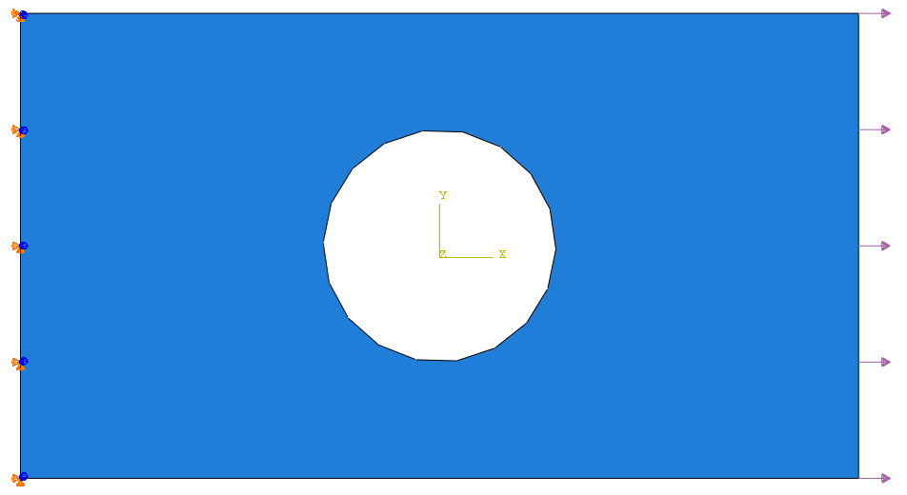
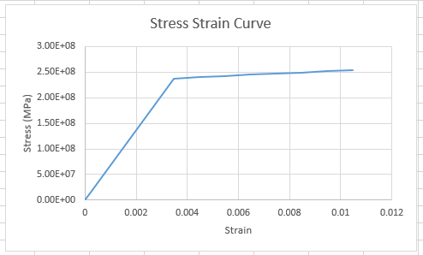
Model Dims
36mm
Fixed end
5mm
Applied Load (σ)
20mm
Elastic Properties:
E = 68.7 GPa
v = 0.2
σy = 238 MPa
Et = 2.2 GPa

Slide 3
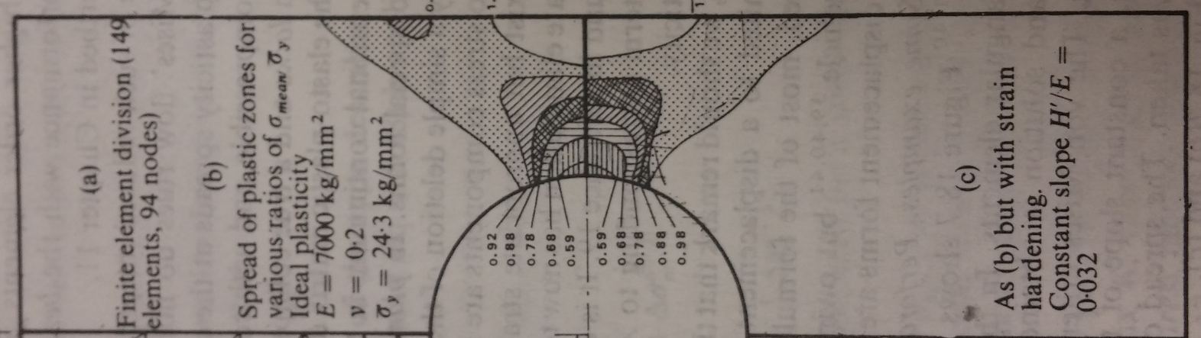
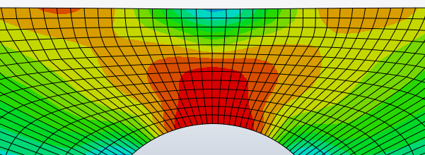
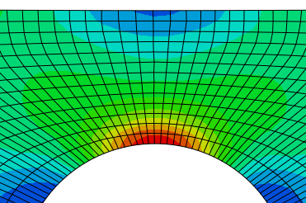
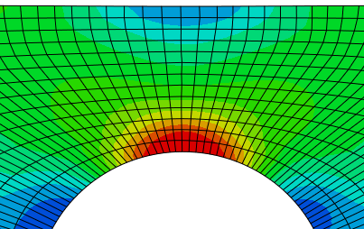
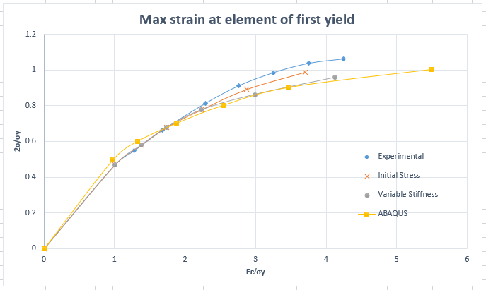
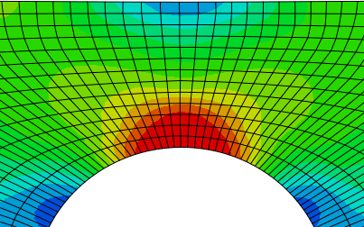
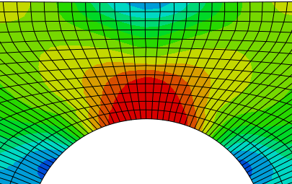
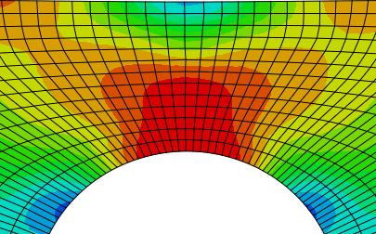
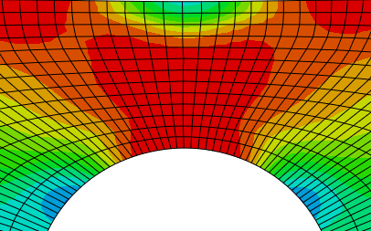
Results
0.5
0.6
0.7
0.8
0.9
1.0
Stress Plots

